Slide 1

Merritt College In-Person Celebration
Congratulations!
Celebrating Our Diverse & Inclusive Merritt College Community

Slide 2

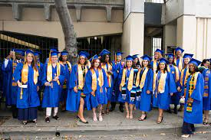
Wednesday, May 20, 2026 5:30 PM – 7:30 PM Paramount Theatre 2025 Broadway, Oakland, CA 94612 *The ceremony will be recorded, not live-streamed*
Join the Celebration!!

Slide 3
Meeting Place: 21st Street (side of theater) Street will be blocked off Check-In: 3:30 PM – 4:30 PM
Graduate Arrival
ALL GRADUATES MUST ARRIVE BY 4:30 PM

Slide 4
Graduate Attire
All graduates must wear a cap and gown. This is your ticket into the theatre.
This year, Merritt College Basic Needs Center has purchased caps and gowns for all graduates. The Bookstore will distribute caps and gowns at the grad fair on May 7, 2026, at 5 PM, Student Activities/Cafeteria.
Student Activities will distribute caps and gowns until May 19th, 2026.
The district and campuses are closed on May 15, 2026, in observance of the Malcom X Holiday.

Slide 5
Programs
All graduates will receive a Commencement Program.
Graduate programs will be in your seat, inside the theatre.
The list of graduate names has been sent to the printer. We’ve done our best to include everyone’s name, based on the information we were provided.
Students who are graduating in Summer 2026, your name will not be included in the program until you finish your degree or certificate.
If you petitioned late, regardless of the reason, your name may not be in the program.

Slide 6
Graduate Check-In Station
Check in by last name (A-L, M-Z)
Graduates will receive a card to write their name and the degree or certificate that will be announced when you walk across stage(only 1 degree or certificate will be called)
Water and snacks will be available
Bathrooms are available inside theater

Slide 7
Lining Up Graduates
Line will be assembled at 4:30 PM
Lines of 2 will be formed
If you would like to sit with friends, make sure your friend is in the front or the back of you in line
If you are unable to stand for 2 hours in heels, bring flats to change into.
Please do not bring any big bags; small wallets/purses are recommended.

Slide 8
Processional
Be prompt. Don’t be Late!
The ceremony begins @ 5:30 PM.
Graduates will be led by ushers

Slide 9
Name Card: Provide to name readers Stage: Shake Hands/Receive Diploma Cover Photo: Before Stage Exit
Walking the Stage
RETURN TO SEAT UNTIL THE LAST GRADUATE IS CALLED!! All GRADUATES WILL PROCESS OUT TOGETHER

Slide 10
Grad Images www.gradimages.com Contact Card will be @ Graduation Will be contacted by email regarding photos
Commencement Photographer

Slide 11
Theatre Rules
No smoking or vaping are permitted anywhere in the Theatre.
All bags subject to search upon entry
NO feet on seats; NO standing on the chairs or on the arm rests
Fire Code regulations state that aisles must remain clear at all times.
Photographs may be taken from the seating area and outside after the ceremony.

Slide 12

District and College Expectations
This is an off-campus event, sponsored by Peralta Community College District and Merritt College.
Graduates are expected to abide by BP 5500 (Student Code of Conduct) and BP 7380 (Ethic, Civility, and Mutual Respect).
Visitors and Guests are expected to abide by AP 7380.
Failure to adhere to the Theatre rules and District/College expectations will result in immediate removal from the premises and ceremony.

Slide 13
Prohibited Items
Flower bouquets, balloons & signs
Flower leis are allowed (available for sale near entrance)
Food or drinks
Bags larger than 18” x 12” x 12”
Laser pens, selfie-sticks, Go-Pros, masks, sealed or wrapped packages, tripods, glitter, silly string, confetti, streamers, banners, or flags and noisemakers such as but not limited to air horns, whistles, cow bells

Slide 14
Guest Information
Doors open at 4:30 PM
Enter through Broadway entrance
All guests will go through security screening when they enter
Must have a ticket to enter (babies also require a ticket)
No assigned seating
DO NOT RUN UP TO THE STAGE

Slide 15
Guest Information
Graduation is a time for family and friends to celebrate. Active cheering and enthusiasm are encouraged, and
Individual conduct or behavior cannot be unreasonable to offend others or be unreasonably abusive to Paramount Theatre staff and volunteers.
Guests using foul language or exhibiting unreasonable behavior are subject to eviction.
The Paramount Theatre staff reserves the right to evict guests whose behavior seriously affects the ability of others to enjoy the graduation ceremony

Slide 16
Guests with disabilities may be dropped off at the front doors on Broadway and may wait inside the outer lobby area before the doors open. There is no elevator in the Paramount Theatre. The Theatre does not provide wheelchairs. The Theatre strives to provide an accessible venue for all guests, designated seating for guests with limited mobility and/or using a wheelchair is provided on the main level of the auditorium, on a first-come, first-served basis. One guest may accompany them in the designated seating area. Please notify Frances Moy (fmoy@peralta.edu) if you or your guest require accommodations by Thursday, May 14, 2026. A list of guest names who may require mobility assistance will be provided to the Paramount Theatre. Wheelchairs that will not be used in the theatre can be checked in at will call.
Accessibility Services

Slide 17
Public Transportation: Please encourage family and friends to take public transportation. The 19th Street BART Station is less than 100 feet away from the Theatre’s front doors on Broadway. Parking: Street parking is limited. The closest parking garage to the Paramount Theatre is the Telegraph Plaza Garage located at the corner of Telegraph and 21st Street. The entrance to the garage is on Telegraph Avenue. Payment is required. Please plan to arrive early.
Parking Information

Slide 18
Tickets & Will Call
Tickets
Graduates will receive 8 tickets. An email will be sent on May 17th, with information about picking up extra tickets.l
If you do not plan to use all your tickets, please return them to the Office of Student Activates or will call for others to use
Graduates can leave tickets at will call for guests to pick up
If you would like to designate another person to pick up tickets, please send email with person’s name to mc-studentactivities@peralta.edu
Will Call
Will call will be located near the Broadway entrance
Strollers can be checked in at will call

Slide 19
COVID-19 Protocols
In line with current mandates, we no longer require masks, proof of vaccination, or a negative COVID test to enter the Paramount Theatre. However, we strongly encourage you to get vaccinated and boosted to keep our community healthy and thriving.
Masks are strongly recommended for all events. It is recommended that whenever possible, everyone wear a non-vented respirator, such as an N95, KN95, or KF94 respirator, or a well-fitting surgical mask with a cloth mask over it.

Slide 20
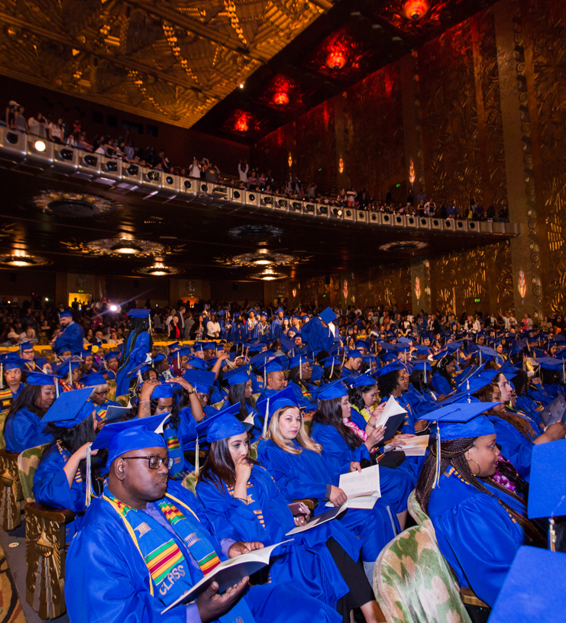
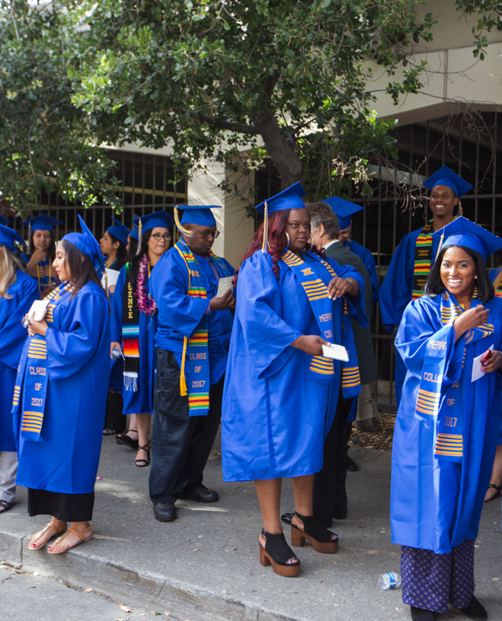
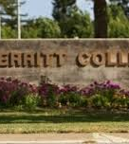
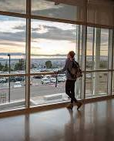
CONGRATULATIONS
Class of 2026!!!

